Slide 1
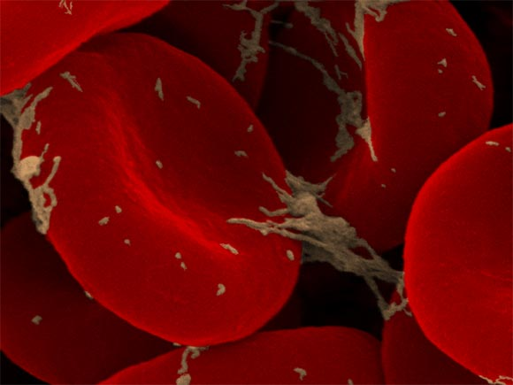
Stem Cells

Slide 2
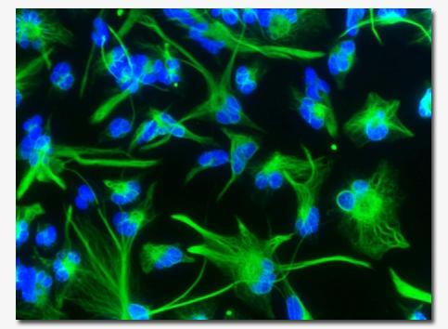
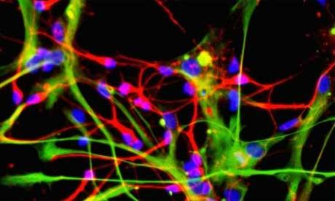
What are stem cells?
Stem cells are cells found in most multi-cellular organisms.
They are cells that have the ability to grow and become many different cell types in the body during early life and growth.
Stems cells are characterized by the potential to renew themselves through mitotic cell division

Slide 3
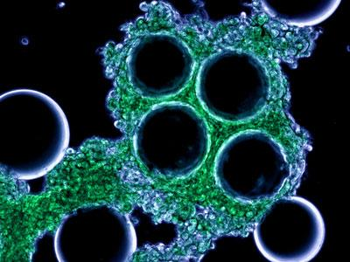
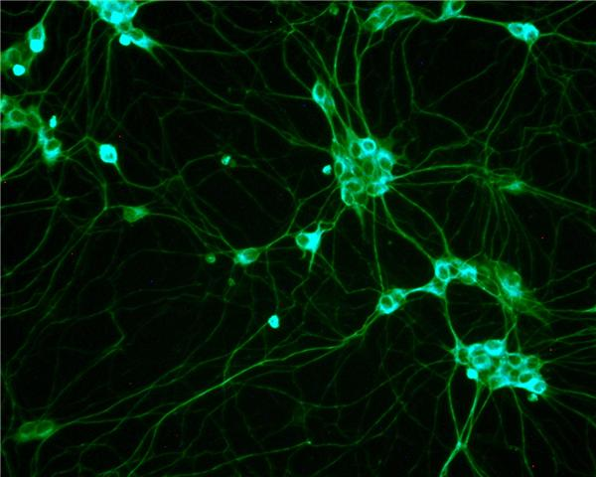
What are stem cells? (Cont…)
They also serve as an internal repair system in many tissues.
They divide, with no limits to replace other cells while the person or animal is alive.
When a stem cell divides, each new cell has the ability, to stay a stem cell or to become another type of cell with a more specific function, such as a muscle cell, a red blood cell, or a brain cell.

Slide 4
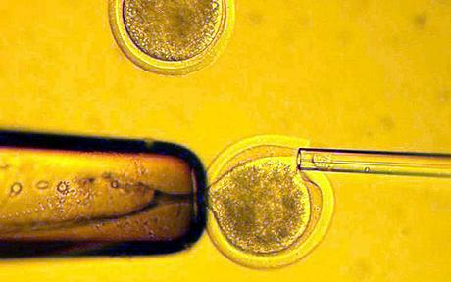
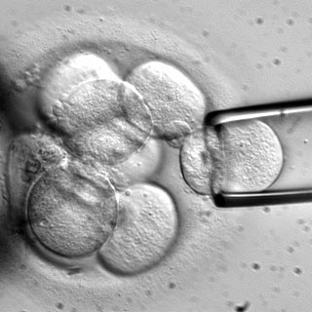
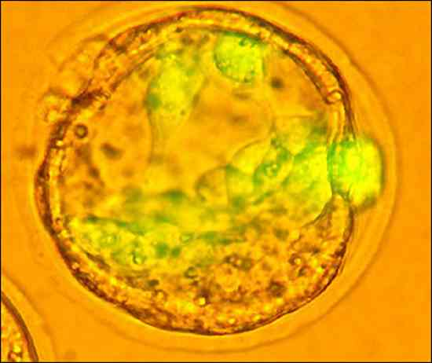
Different types of stem cells
Embryonic stem cells - are harvested from the inner cell mass of the blastocyst seven to ten days after fertilization.
Fetal stem cells - are taken from the germline tissues that will make up the gonads of aborted fetuses.
Umbilical cord stem cells - Umbilical cord blood contains stem cells similar to those found in bone marrow.

Slide 5
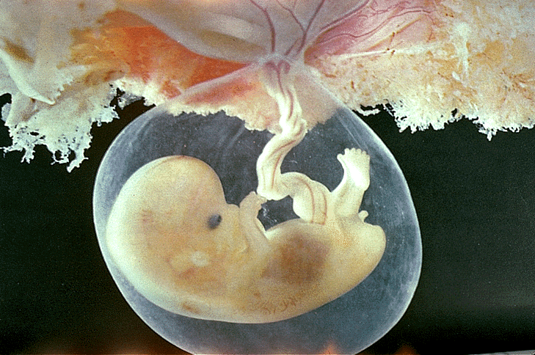
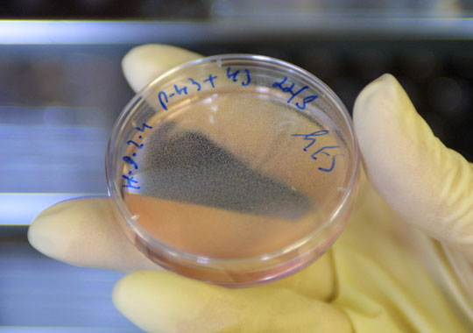
Different types of stem cells…
Placenta derived stem cells - up to ten times as many stem cells can be harvested from a placenta as from cord blood.
Adult stem cells - Many adult tissues contain stem cells that can be isolated.
http://www.godandscience.org/slideshow/stem005.html#9QkIO1Qghm9A | Last Modified July 6, 2004

Slide 6
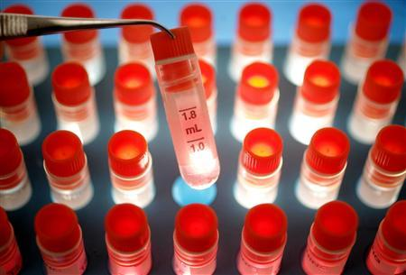
Issues
Ethical- is using an embryonic cell for stem cell research the same murder
Legal- should the public and government help policymakers decide whether and in what ways stem cell technologies should be regulated by the government.
Social- how do stem cells affect the society as a whole?

Slide 7
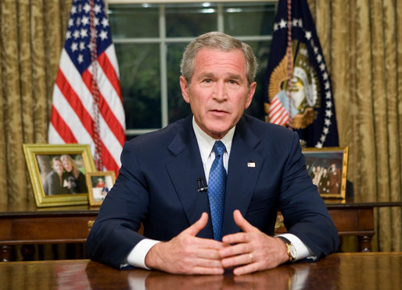
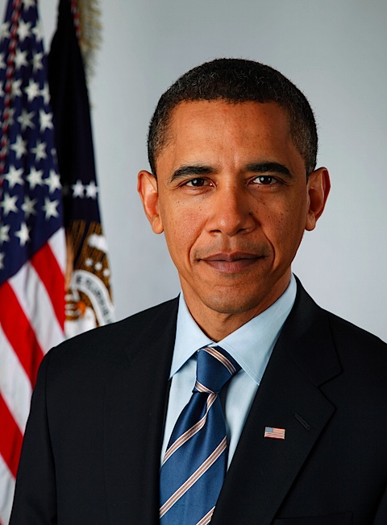
Impact
President George W. Bush vetoed the House Resolution 810 Stem Cell Research Enhancement Act, which was a bill that would have reversed the Dickey Amendment which made it illegal for federal money to be used for the research where stem cells are taken from the destruction of an embryo, on July 19th 2006
President Barack Obama signed the executive order reversing federal opposition to embryonic stem cell research., which allows for federal funding of stem cell research., on March 9th 2009

